Slide 1
C3S.COM (Campus Connect Classroom Scheduling System)

Slide 2
Introduction
C3S.COM is a user friendly web-portal which provides solution to all the problems related to students.
It consists of all the data management and storage facilities that are required for effectively managing a class and teaching multiple courses and subjects.
It consists of multiple teachers and faculty accounts along with their classroom and subject related status.
The system helps in effectively managing and scheduling batches of students as per their courses and exam priorities. Benefits are as follows:
Eliminate Paper-Based Process
Intuitive and User-Friendly
Generate Multiple Timetables
Secure
Easy Integration

Slide 3
Analysis of existing System
The existing business process provides facilities such as searching for instructor for students, receives payments for registering of both instructor and students in their portals. It provides online support to the students if tutors are available.

Slide 4
Limitations of the existing System
The existing business system although provides online support but fails to provide online material to the students.
Moreover, the materials often provided doesn’t contain total solutions to the problems of the students.
There is no process to retrieve the progress report of the students and reviewing for the tutors as well. However, existing portals have a large audience to listen and follow.
There is no provision of direct chatting to the tutors (if they are available) by the existing system

Slide 5
Purposes of This Project
To provide a list of available instructor to the searching student or parent.
To provide non payable classes.
To provide authentic study materials (whichever the administrator may find) available for download to all the registered student.
Providing recent research and development news related to the subject by the administrator of the website in their respective portals.

Slide 6
Benefits of the Project:
The system includes the students, tutors. Benefits to each of these are described below.
Benefit to Students:
With availability of instructors, the student may find it a flexible mode to study and understand the subject in a better way, as he has guidance of the best teacher’s for the particular subjects. If in offline mode the student won’t be able to put in extra effort, then it can find the tutor in their profile chat section and ask for their doubts and queries.

Slide 7
Benefit to Tutors:
The tutors may find a good source of income through the web-portal and also the talented batch of students whom they wish to teach and will be able to forge their path for the future. They may also comment on the performance of the student. They will be able to interact with all the students one-on-one which is not possible in offline classes.

Slide 8
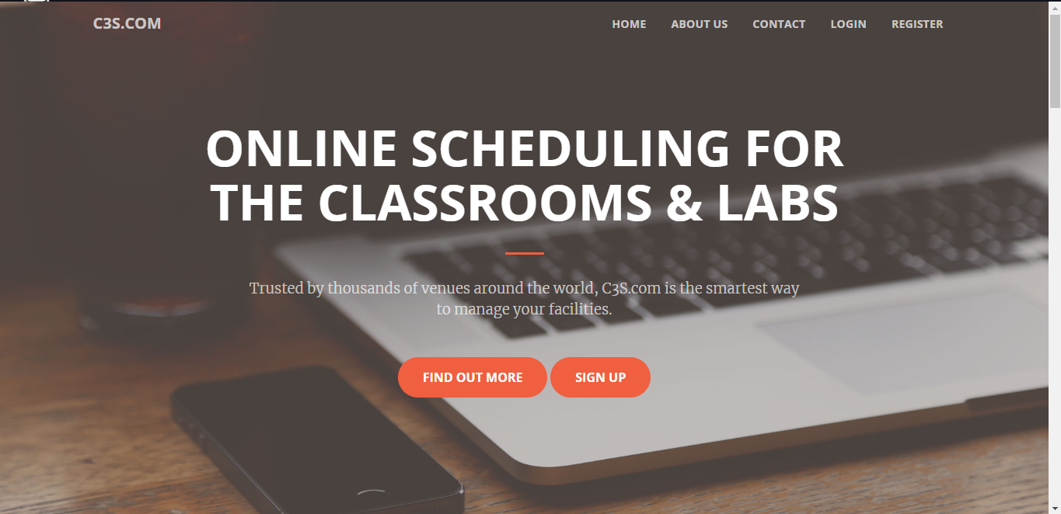
Output Screens
Home Page of C3S.COM:
This is the main page of the “C3S.COM”. It contain the basic information related to the “CAMPUS CONNNECT CLASSROOM SCHEDULING SYSTEM”.

Slide 9
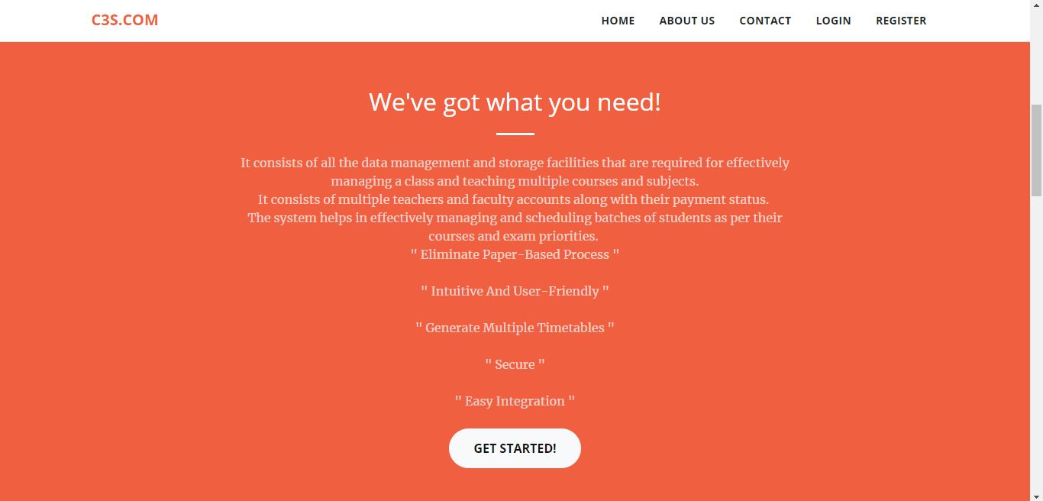

Slide 10
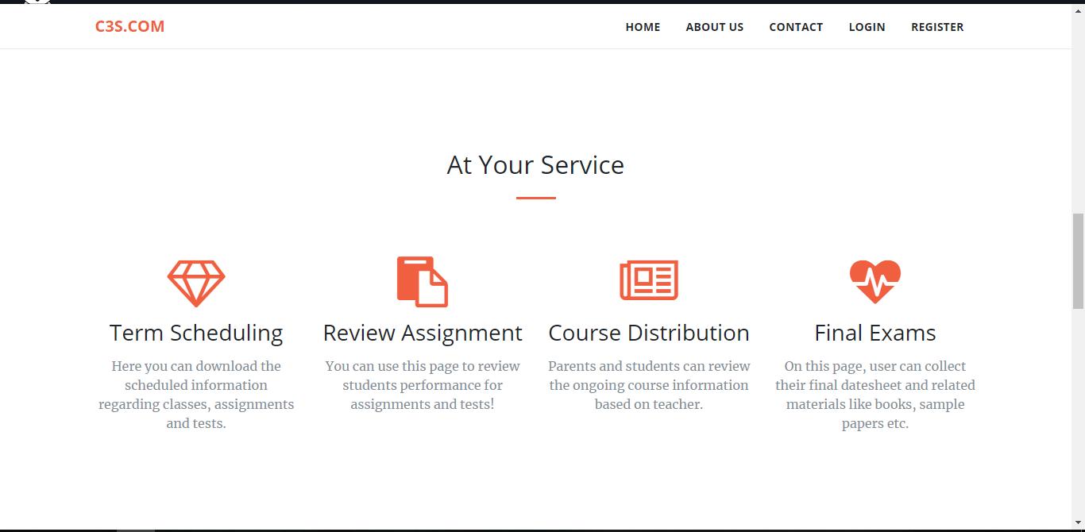

Slide 11
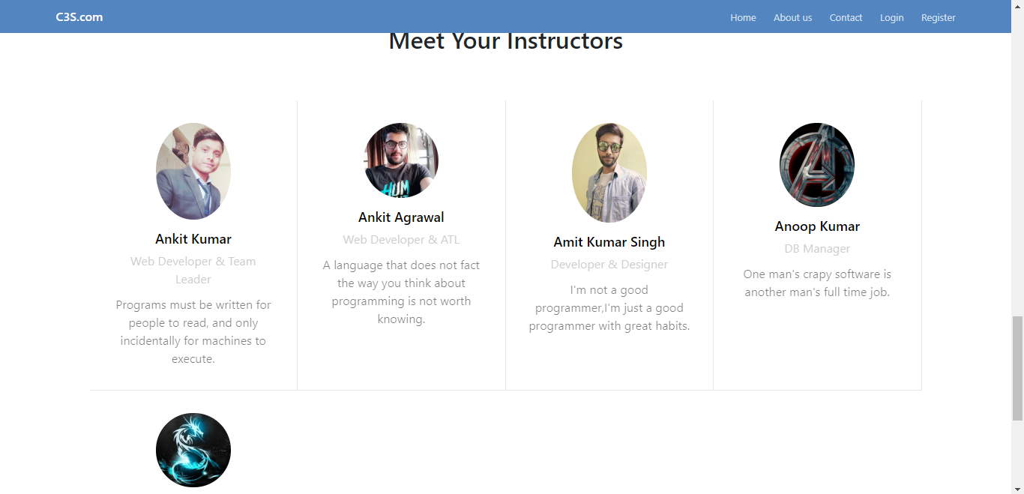
About us:
This page shows the instructor details.

Slide 12
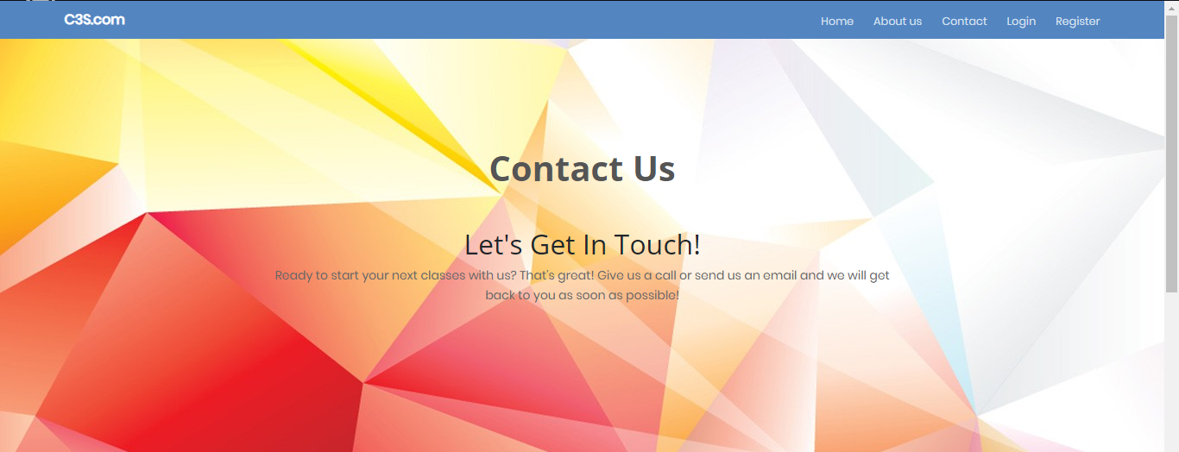
Contact Us:
This page can be used to provide feedback and queries related to faculty and courses.

Slide 13
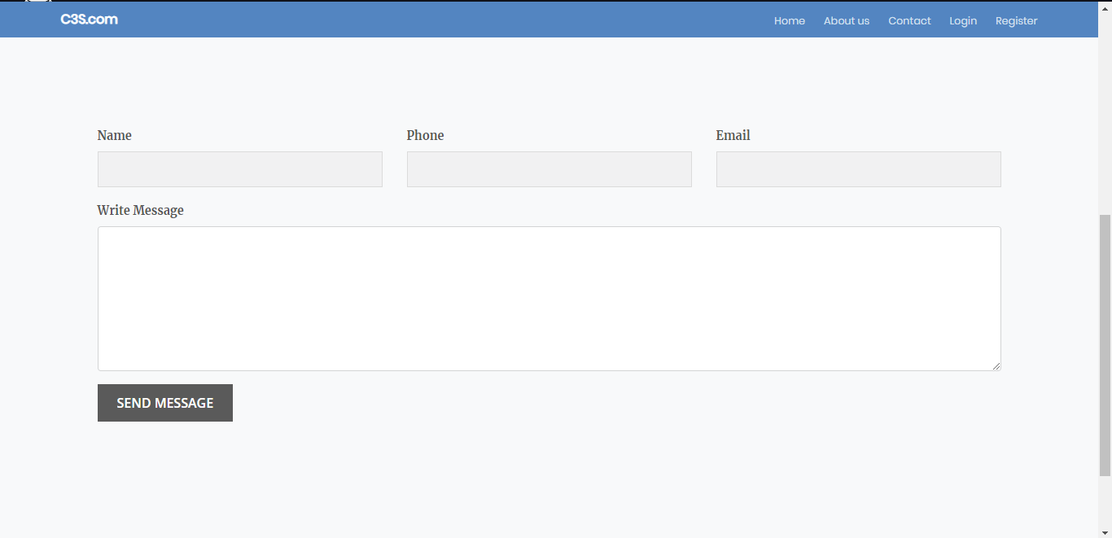

Slide 14
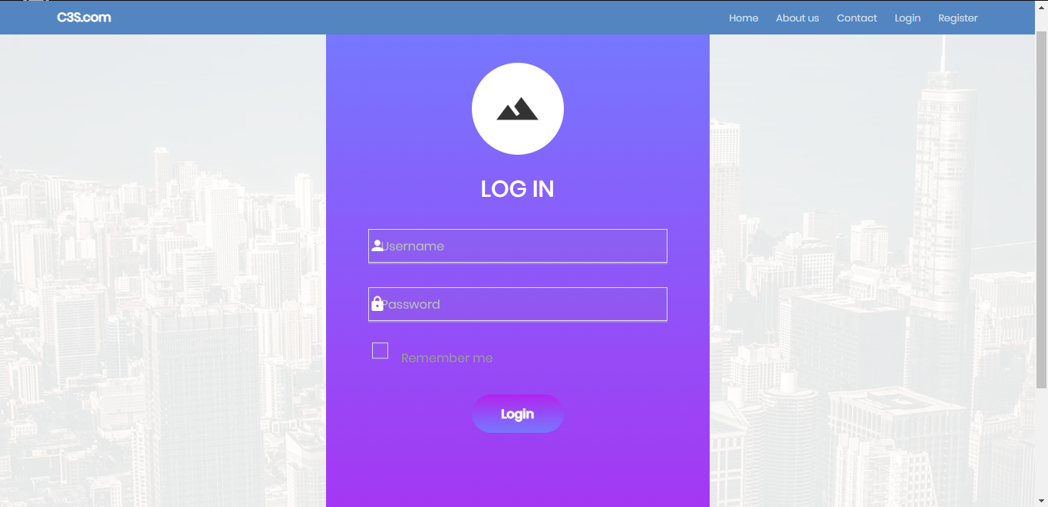
Login:
The login form contains the fields namely Username and Password. It will also contains the Forget Password options.

Slide 15
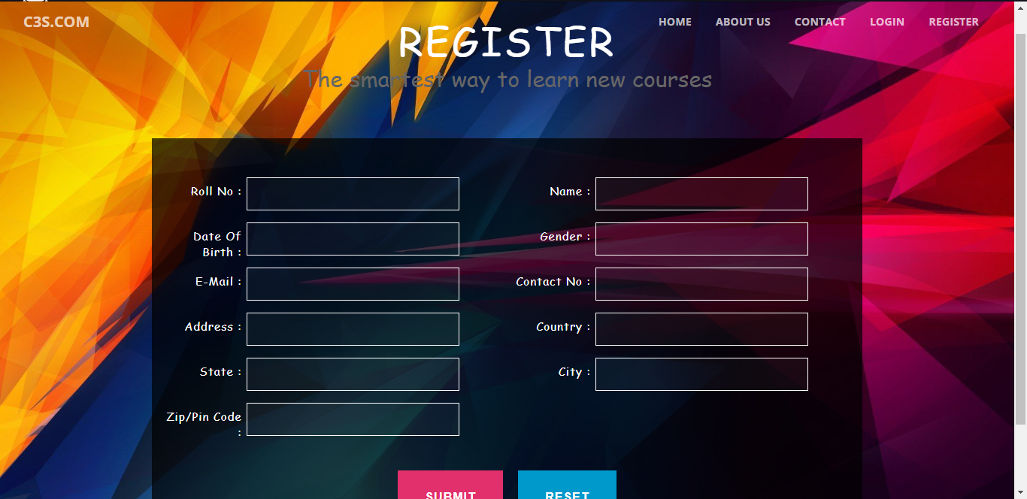
Register:
This page is used to register the students in C3S.COM. It contains the various fields i.e. Roll No., Name, DOB, Gender, Email, Contact, Address and Password etc.

Slide 16
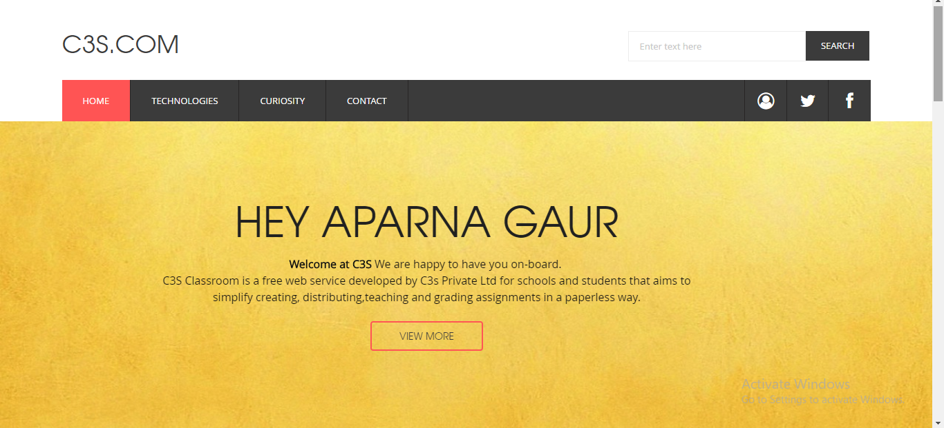
Profile:
This is the page which will appear after the student successfully logins into the system.

Slide 17
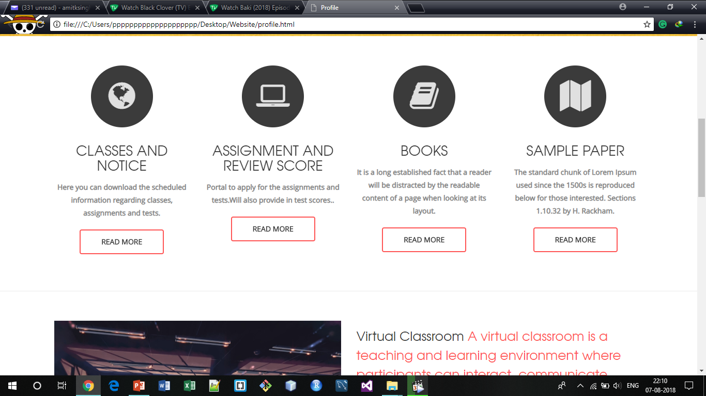

Slide 18
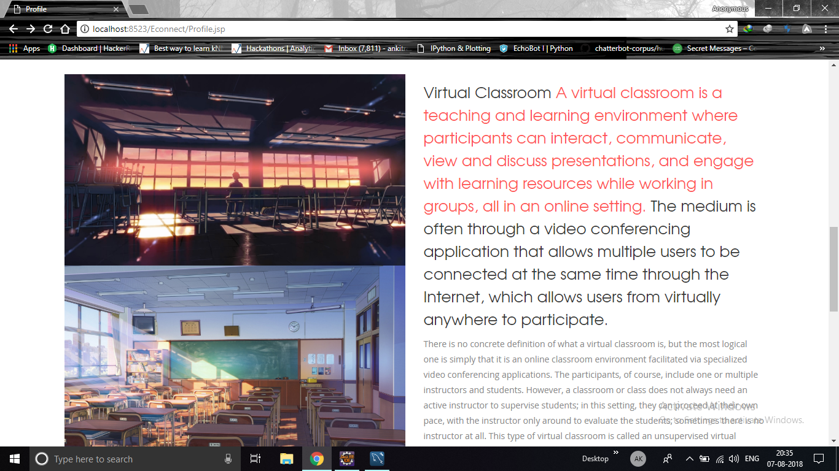

Slide 19
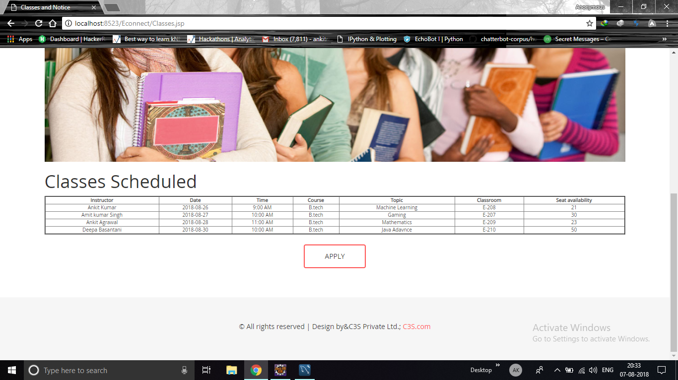
Classes and Notices:

Slide 20
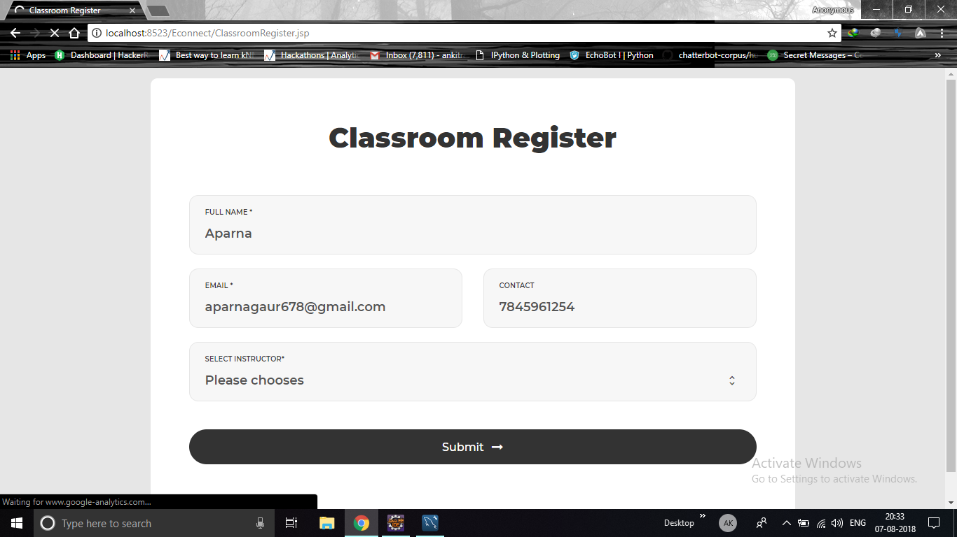

Slide 21
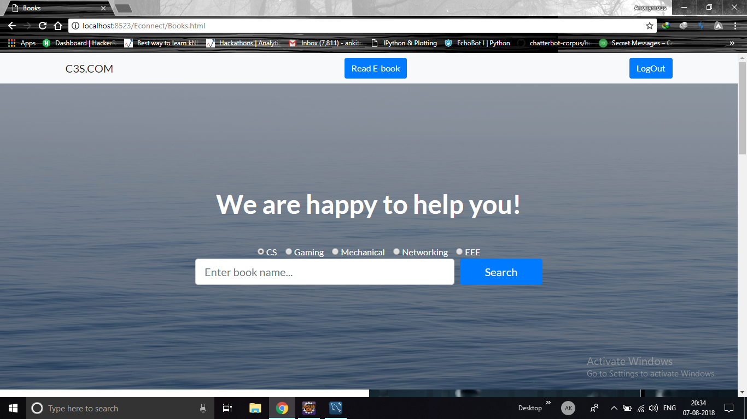
Books:

Slide 22
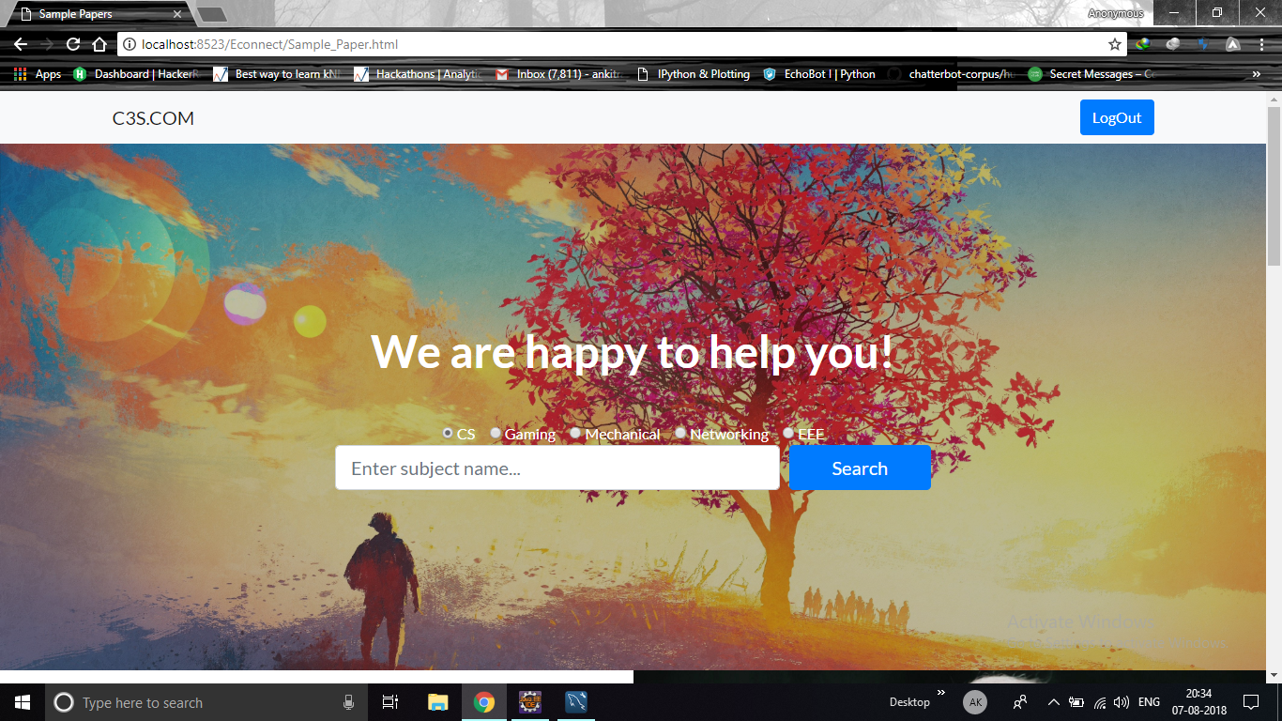
Sample Paper:

Slide 23
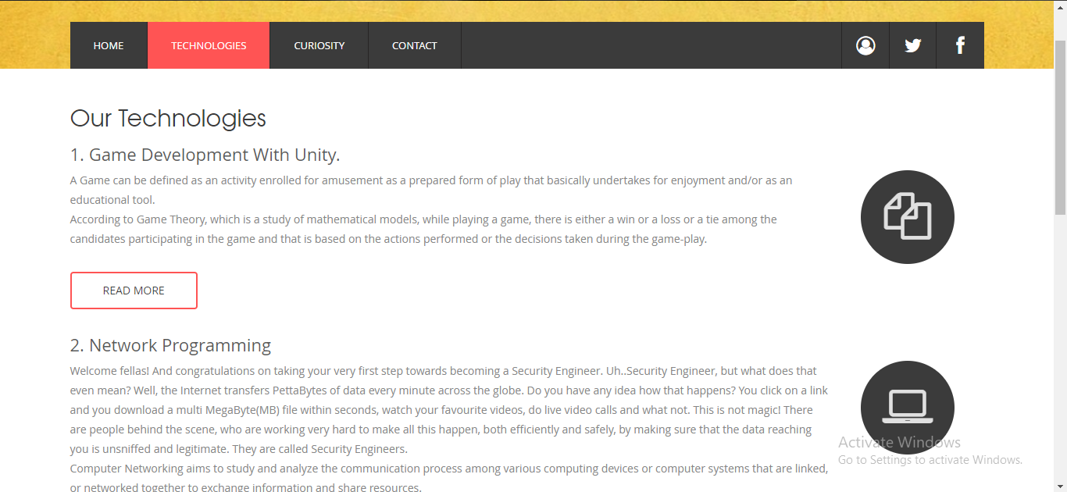
Technologies:
This web page contain the extra technology for the betterment of the students to gain some extra knowledge.

Slide 24
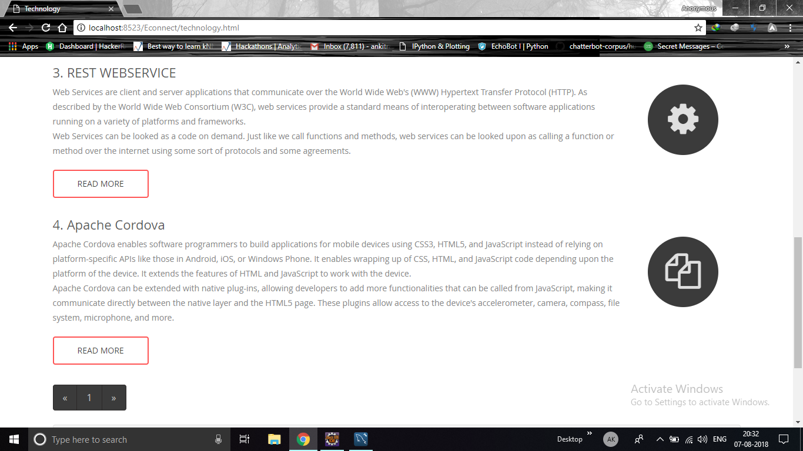

Slide 25
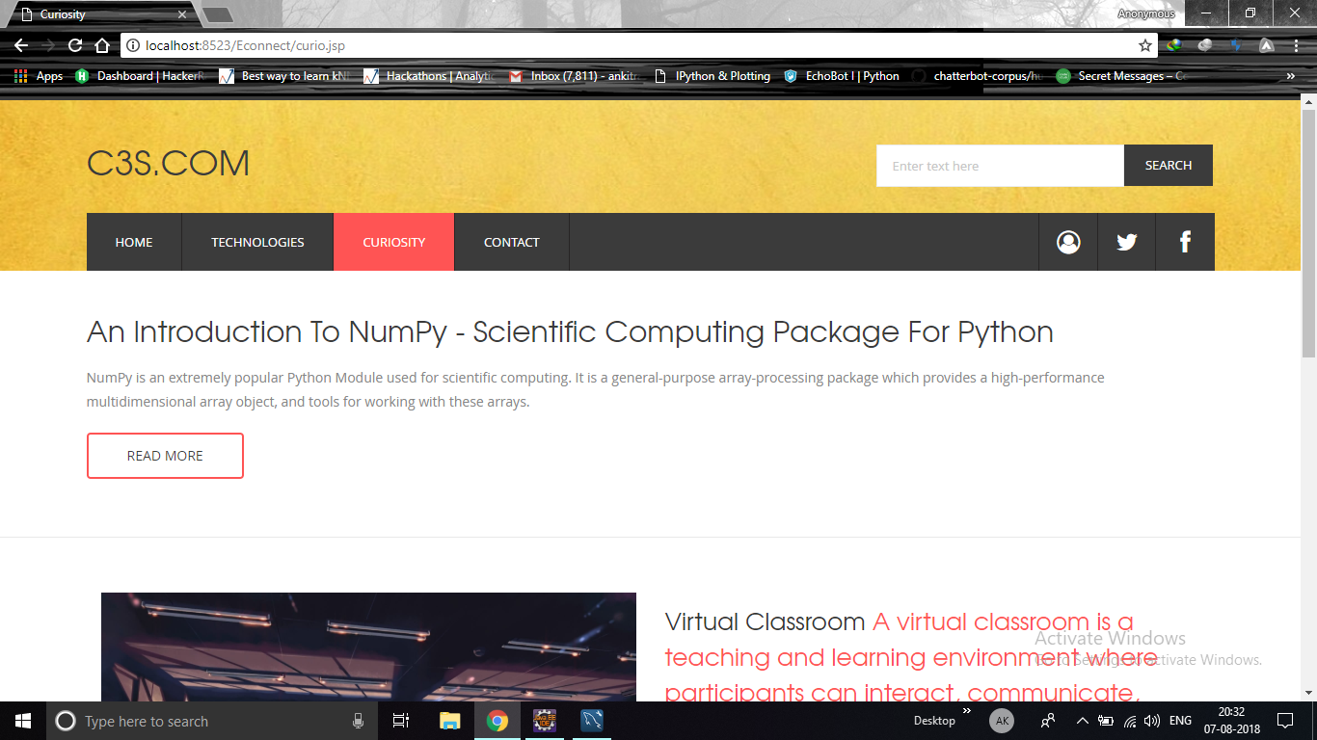
Curiosity:
This is the curiosity page which keeps changes every time the user visit this page and provide the latest and most interesting technical and knowledgeable topics.

Slide 26
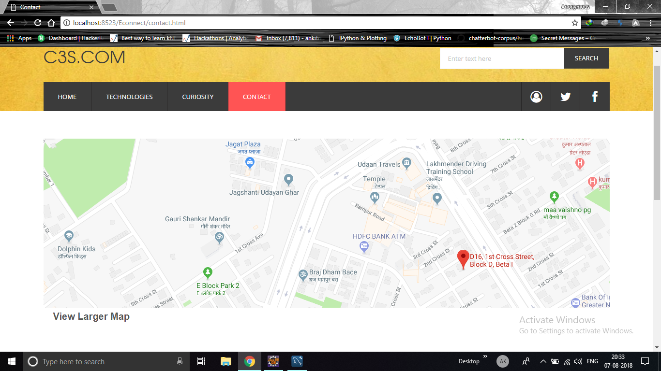
Contact Us:

Slide 27
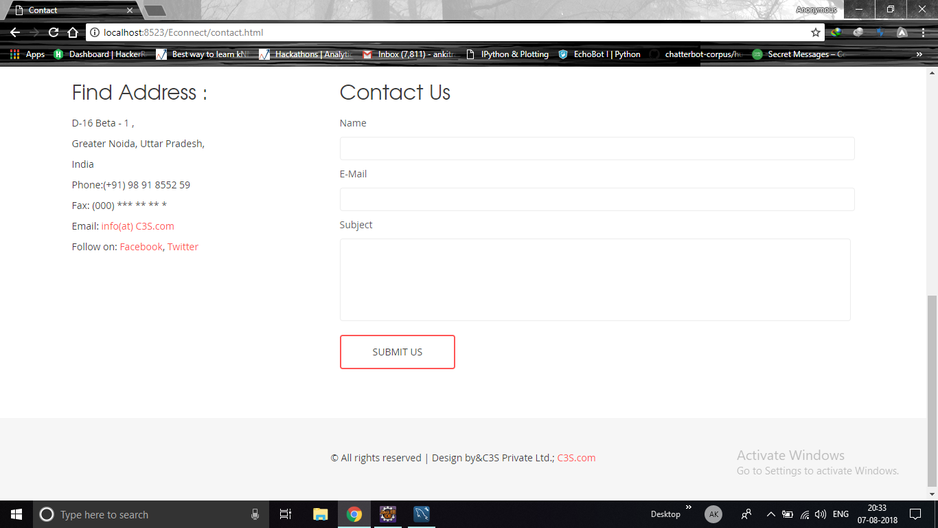

Slide 28
Thank You
Name: Amit Kumar Singh
Roll No.: 1509010027
Class: CS-4A

